Slide 1

Walmart sparkathon 24
Smart Yard:
Visual AI-Driven Supply Chain Manager
By team: codepandas

Slide 2


Problem statement
A major issue that walmart supply warehouses faces maintaining supervised control over yard, which includes tracking trucks, detecting objects and recording supply logs at the operational level.
Moreover the traditional tracking often lack real-time visibility, receiving low quality logistics data, and more safety risks.

Slide 3


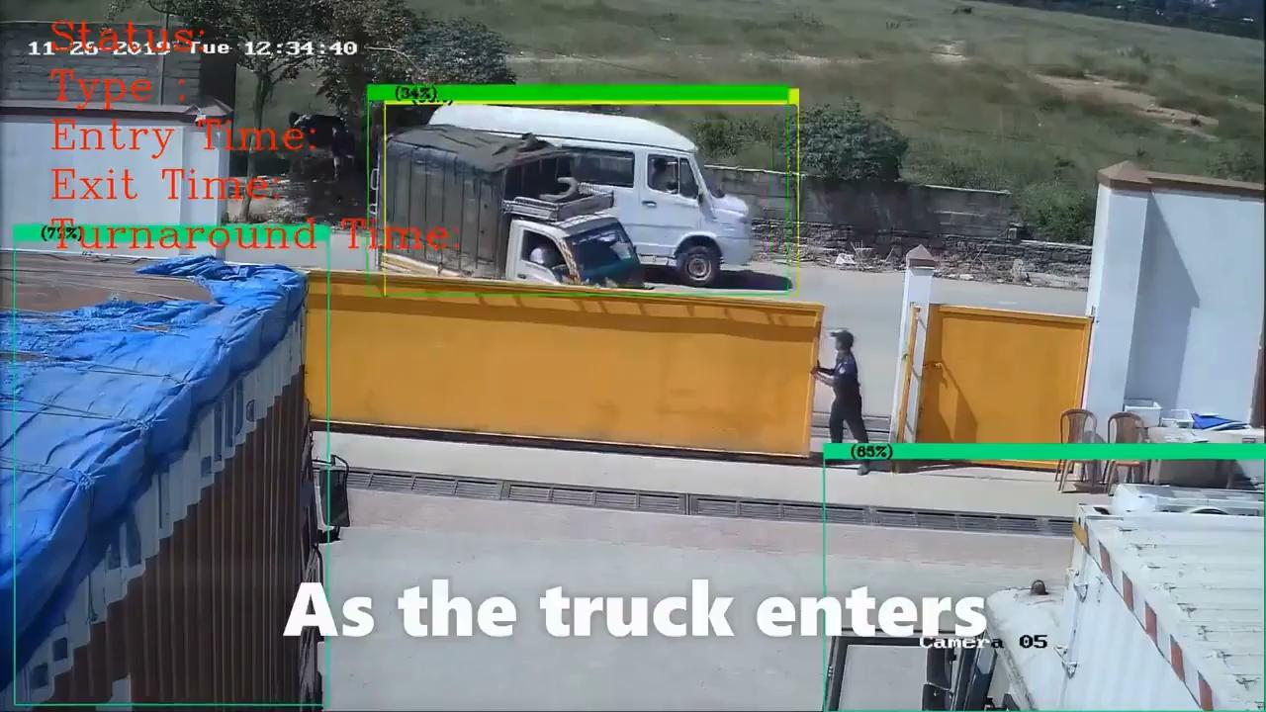
Solution
To address these challenges, we have developed an AI-powered computer vision system designed to solve tracking and detection issues in logistics.
Our system automatically tracks trucks within a yard, extracting crucial details such as license number, truck ID, trailer ID, trailer size, current status, and precise locations using the existing CCTV cameras, GPS and rfid scanners.
The model is also capable of identifying truck docking status at pods, providing live updates on goods being loaded or unloaded. Additionally, it detects anomalies like punctured trailer wheels, open doors, or potential thefts.
Another key feature of our system is automated real-time data logging. This technology converts monitored video data into textual data, stored in a database for easy retrieval and analysis. These advancements not only enhance supply data analysis but also significantly improve productivity, product quality, safety, and overall operational efficiency.

Slide 4
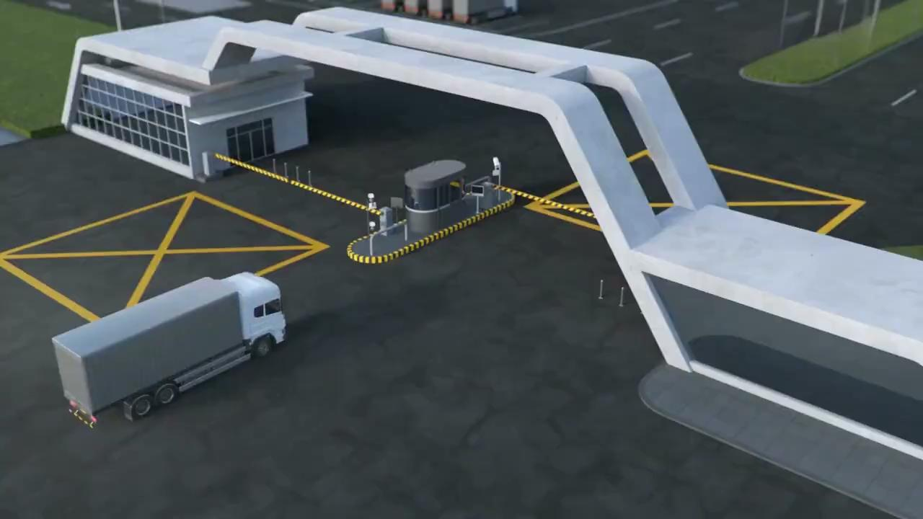
Solution

Slide 5
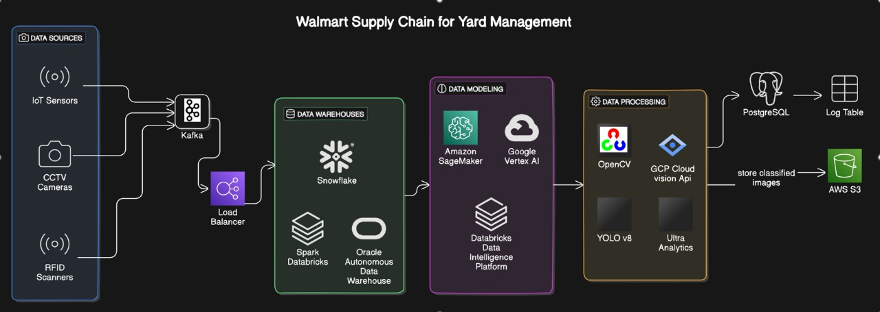
System plan + Eco system - integration
Data Collection and Ingestion
Walmart uses cameras, RFID, and IoT sensors to collect truck data. This data is sent to a central system via Kafka.
Data Processing and Storage
Data is stored in cloud data lakes (Snowflake, Databricks, Oracle) for analysis. Real-time data is processed using AI models (SageMaker, Metaflow) and computer vision (OpenCV, YOLO v8, Ultra Analytics).
Output and Storage
Processed data (videos, logs) is stored in PostgreSQL. This data provides insights into truck traffic, loading/unloading times, etc.
Scalable System
To handle varying workloads, Walmart uses a load balancer to adjust processing resources. This ensures efficient data handling.

Slide 6

Technical implementation
Data Capture:
Setup Cameras: Install and configure high-resolution cameras at strategic locations.
Capture Images/Videos: Using OpenCV to precise tracking and focusing more on the objects.
Image Processing:
Pre-Processing: Use OpenCV for tasks like resizing, filtering, and normalization of images.
Object Detection: Implement models like YOLO to identify and track trucks and cargo.
Text Extraction: Use OCR tools to read license plates and labels.
Data Management:
Store Logs: Save extracted data (e.g., truck IDs, cargo details) to a database in a structured format.
Real-Time Processing: Use a streaming platform to process and analyze data in real-time.
Integration:
APIs: Develop APIs to integrate with existing logistics software and dashboards for data access and reporting.
User Interface: Create dashboards for visualizing data and managing system operations.
Deployment and Maintenance:
Deploy: Use cloud services or on-premises servers for application deployment.
Monitor: Set up monitoring tools for system performance and maintenance

Slide 7
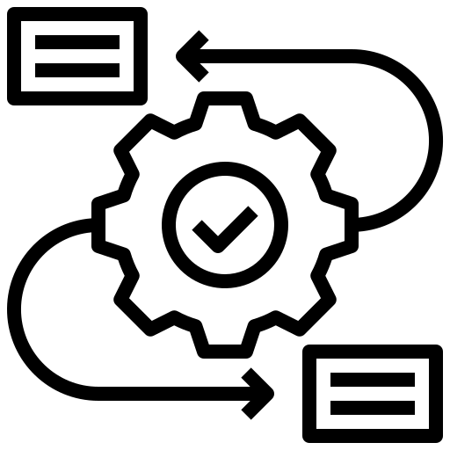
Results and Use case
Truck Movement Insights: Beyond real-time tracking and cargo detection, our system provides valuable insights into truck movements, speeds, and optimized arrangements within the yard.
Efficient Event Logging: Visual events are logged to ensure effective recording and long-term data storage with minimal space requirements.
Predictive Maintenance and Compliance: The system can predict truck maintenance schedules, assess wear and tear, ensure regulatory compliance, and manage authorization processes.
Seamless Integration: Stored information in NoSQL databases can be easily connected to analytical tools like Tableau for real-time visualizations.
Enhanced Security Monitoring: Continuous monitoring helps detect security anomalies, potential tampering with vehicles or cargo, and other threats, ensuring a secure supply chain environment.

Slide 8
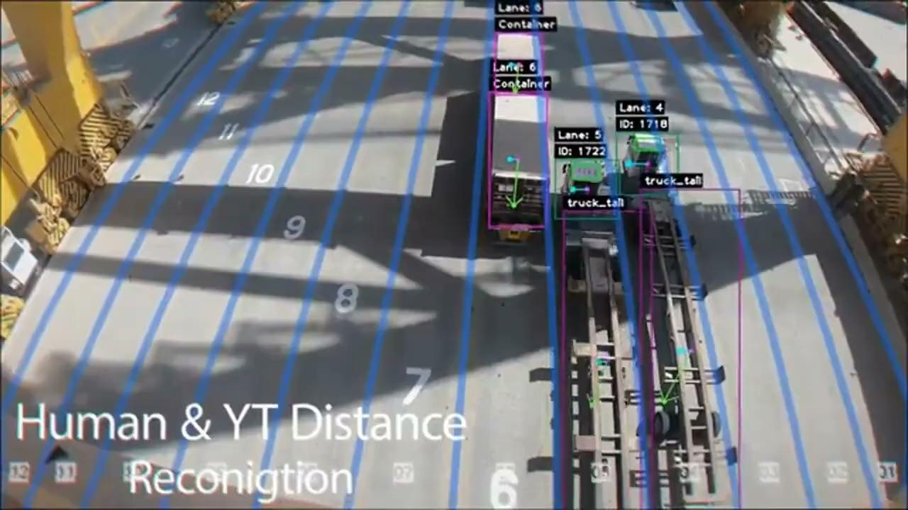
Future scope
Comprehensive Cargo Tracking: Beyond current capabilities, computer vision can enable complete tracking and positioning of cargo, as well as smart, optimized arrangements of goods on shelves.
Advanced Anomaly Detection: The system could detect various anomalies in real-time, such as theft, potential fires, shelf instability, and accidents, enhancing overall safety and security.
Enhanced Goods Analysis: Enabled cargo tracking will allow for detailed analysis of supply chains, including cargo damage detection, metadata recording (e.g., cargo size, received time, storage areas), and more.
Worker Monitoring: Computer vision can also track worker efficiency, ensure safety gear compliance, monitor positions and distance between vehicles in yard, and even facilitate quick, face-recognized attendance.
Data-Driven Insights: The logged data can be analyzed for insights, with capabilities such as sentiment analysis to classify anomalies, text summarization to highlight key events, and optimized cargo arrangement recommendations

Slide 9




Introduction to team
Devesh
Srijan Saswat
Soham
Saurajyoti Bhattacharjee
Backend , Deep Learning and System design
Computer Vision and Deep Learning
Modeling and content creation
Backend and Machine Learning

Slide 10
Thank you
This is what it is

